Slide 1
JDBC
Java Database Connectivity

Slide 2
Java Database Connectivity (JDBC)
Introduction to JDBC: Setting up the database, connecting to a Database: The Connection Interface, connecting to the database using Driver Manager, Querying and Updating the Database: Statement Interface, Result Set Interface, Querying and Updating the Database

Slide 3
What is JDBC?
JDBC stands for Java Database Connectivity
A standard API for accessing databases from Java applications
Supports various databases such as Oracle, MySQL, and SQL Server
JDBC abstracts the database access mechanism
Allows Java programs to be database-independent.

Slide 4
Purpose of JDBC
Connect Java applications to relational databases
Execute SQL statements from Java code
Fetch data from databases and process results
Insert, update, delete records in the database
Manage database connections and resources effectively

Slide 5
Benefits of JDBC
Cross-platform compatibility
Write once, connect to any database with minimal changes
Easy to learn and integrate into Java applications
Supports transaction management and batch processing
Extensive error handling with SQLException

Slide 6
Common JDBC Use Cases
Web-based applications with a backend database
Enterprise applications needing data storage and retrieval
Desktop applications with local databases
Reporting systems accessing data in real-time
Integration with legacy databases using JDBC-ODBC bridge

Slide 7
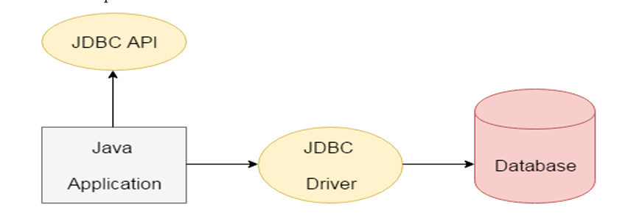
JDBC Architecture Overview
JDBC API is a bridge between Java and databases
The architecture consists of the JDBC Driver Manager and Driver
JDBC Drivers handle database communication
Java code interacts with the JDBC API, which uses SQL queries
JDBC Driver translates API calls into database-specific instructions

Slide 8
Setting Up the Database

Slide 9
Prerequisites for JDBC
Install the required RDBMS (Oracle, MySQL, etc.)
Set up the database system on your machine or server
Download and configure the JDBC driver for your database
Verify the JDBC driver is compatible with your Java version
Ensure you have SQL privileges to create and modify tables

Slide 10
Database Configuration Steps
Step 1: Install the database software
Step 2: Create the necessary tables and schemas
Step 3: Enable network access to the database
Step 4: Create user accounts and assign privileges
Step 5: Test the SQL connection manually before coding JDBC

Slide 11
Sample Database Setup
Example: MySQL installation
Create a test database with simple tables
Tables: students, courses, grades
SQL example:
CREATE TABLE students (id INT, name VARCHAR(50), grade INT);
Populate sample data: INSERT INTO students VALUES (1, 'John Doe', 90);

Slide 12
JDBC Driver Setup
Download the appropriate JDBC driver for your database
Include the JDBC driver JAR file in your project’s classpath
For MySQL: mysql-connector-java-x.x.xx-bin.jar
For Oracle: ojdbcx.jar
Ensure that the driver is compatible with the Java version in use

Slide 13
Connecting to a Database

Slide 14
Overview of Database Connection
JDBC API is used to connect to databases
Java program interacts with the database through a Connection object
DriverManager is responsible for establishing connections
Connection requires URL, username, and password
Once connected, execute SQL queries and update the database

Slide 15
JDBC Connection Process
Step 1: Load the JDBC driver class
Step 2: Use DriverManager to create a connection
Step 3: Create a Statement object for queries
Step 4: Execute the query using the Statement object
Step 5: Retrieve results using the ResultSet object

Slide 16
Loading the JDBC Driver
Load the driver using Class.forName(driverName)
Example for MySQL: Class.forName("com.mysql.cj.jdbc.Driver");
Registers the driver with DriverManager
This step is required to initiate the database connection
Ensures that Java is aware of the driver’s existence

Slide 17
Connecting to the Database
Use the DriverManager.getConnection() method
Connection URL format: jdbc:mysql://localhost:3306/mydatabase
Provide database credentials: username and password
Handle connection exceptions using SQLException

Slide 18
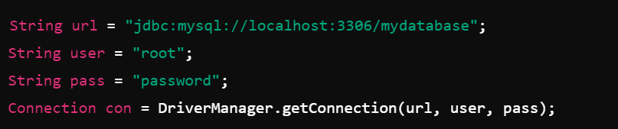
Example Code for Connecting to Database
Ensure the database server is running before connecting
Handle connection issues using a try-catch block
Always close the connection after performing operations
Demo
https://www.youtube.com/watch?v=7v2OnUti2eM

Slide 19
The Connection Interface

Slide 20
Overview of Connection Interface
Represents a session between Java application and database
Used to execute SQL statements and retrieve results
Connection interface has methods for transaction management
Manage database connection lifecycle: open and close connections
Create Statement, PreparedStatement, and CallableStatement

Slide 21
Connection Interface Methods
createStatement(): Create a basic SQL query
prepareStatement(): Create parameterized SQL queries
commit(): Commit a transaction
rollback(): Rollback to a previous state in case of failure
close(): Close the connection and release resources

Slide 22
Managing Database Transactions
Transactions allow for grouping multiple SQL queries
JDBC supports commit and rollback methods
Use setAutoCommit(false) for manual transaction control
Use commit() to save changes to the database
Use rollback() to undo changes if errors occur

Slide 23
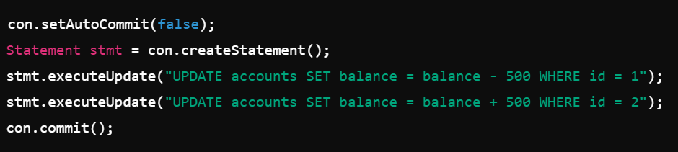
Example Code for Transactions
Handle exceptions to rollback changes if errors occur
Ensure data consistency by using transactions

Slide 24
Closing Database Connection
Always close connections using con.close()
Closing prevents memory leaks and resource exhaustion
Use finally block to ensure the connection is closed
Closing a connection also closes Statements and ResultSets
Best practice: Connection pooling for performance optimization

Slide 25
Connecting to Database using DriverManager

Slide 26
Overview of DriverManager
DriverManager manages the set of JDBC drivers
Responsible for establishing database connections
It matches the database URL with the appropriate driver
Automatically handles loading and unloading drivers
Supports multiple database drivers in one application

Slide 27
DriverManager Methods
getConnection(url, user, pass): Establishes a connection to the database
registerDriver(driver): Manually registers a JDBC driver
deregisterDriver(driver): Removes a driver from DriverManager
getDriver(url): Returns the driver instance for the specified URL
getLoginTimeout(): Specifies how long to wait for a connection

Slide 28

Registering Drivers with DriverManager
Drivers can be registered manually or automatically
Manual registration
Automatic registration via Class.forName()

Slide 29
Managing Multiple Drivers
DriverManager can handle multiple database drivers
Application can connect to different databases concurrently
Ensure the correct driver is used by specifying the correct URL
Example: One app using MySQL and PostgreSQL drivers
Manage driver loading and connection handling carefully

Slide 30
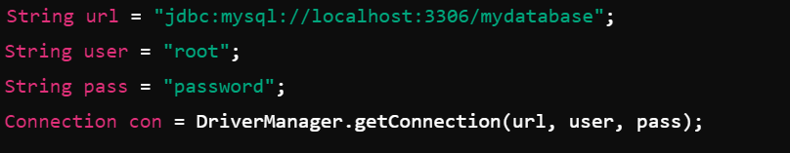
Example Code for DriverManager
Handle exceptions and check for driver issues
Always check if the driver supports the database URL
Demo https://www.geeksforgeeks.org/establishing-jdbc-connection-in-java/

Slide 31
Querying and Updating the Database

Slide 32
Introduction to SQL Queries in JDBC
JDBC allows executing SQL queries to interact with the database
Queries include SELECT, INSERT, UPDATE, DELETE
Queries are executed using the Statement or PreparedStatement interface
Data retrieved is stored in a ResultSet object
Always handle SQL exceptions with proper error handling

Slide 33

The Statement Interface
Used to execute basic SQL queries
Methods:
executeQuery(sql) – for SELECT queries
executeUpdate(sql) – for INSERT, UPDATE, DELETE queries
execute(sql) – for complex queries with multiple results
Suitable for simple SQL commands without parameters

Slide 34
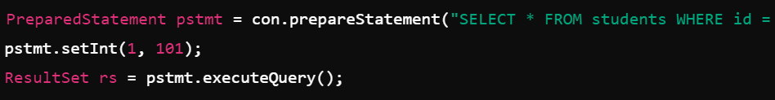
PreparedStatement for Parameterized Queries
PreparedStatement is used for parameterized queries
Precompiles the SQL query for better performance
Avoids SQL injection attacks by using placeholders (?)
Used for queries that are executed multiple times

Slide 35
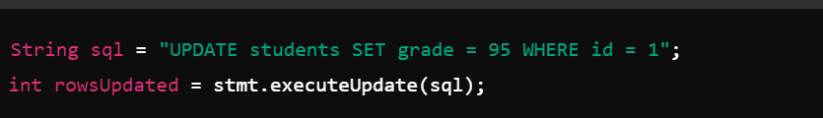
Updating the Database
executeUpdate() is used for INSERT, UPDATE, DELETE queries
It returns the number of affected rows in the database
Use executeUpdate for all DML operations
Always handle exceptions when updating the database
Demo https://www.w3schools.com/sql/sql_update.asp

Slide 36
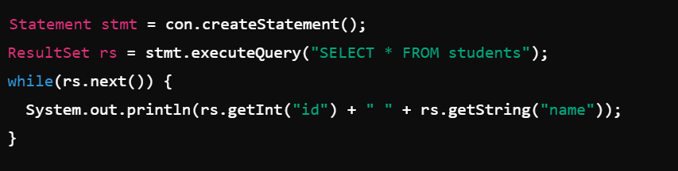
Example Code for Querying and Updating
Querying with Statement
Updating with PreparedStatement
PreparedStatement pstmt = con.prepareStatement("UPDATE students SET grade = ? WHERE id = ?");
pstmt.setInt(1, 95);
pstmt.setInt(2, 1);
int rows = pstmt.executeUpdate();

Slide 37
The ResultSet Interface

Slide 38
Introduction to ResultSet
ResultSet holds the results of SQL queries
Represents data in a tabular format (rows and columns)
Cursors are used to navigate through the result set
ResultSet can be read-only or scrollable
Data is accessed using get() methods (e.g., getInt(), getString())

Slide 39
Types of ResultSet
TYPE_FORWARD_ONLY: Can only move forward in the result set
TYPE_SCROLL_INSENSITIVE: Can scroll forward and backward; does not reflect changes made by others
TYPE_SCROLL_SENSITIVE: Can scroll and reflect changes made by others
Choose the type based on the application's needs
Concurrency modes: CONCUR_READ_ONLY or CONCUR_UPDATABLE

Slide 40
Navigating the ResultSet
Common methods for navigating the ResultSet:
next() – Move to the next row
previous() – Move to the previous row
first() – Move to the first row
last() – Move to the last row
beforeFirst() – Move before the first row
afterLast() – Move after the last row

Slide 41
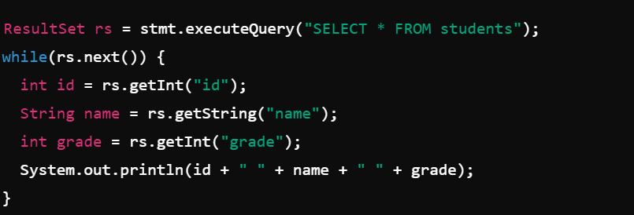
Retrieving Data from ResultSet
Use getInt(), getString(), getFloat(), etc., to retrieve column data
Always use the correct method for the column type

Slide 42
Closing the ResultSet
Always close the ResultSet to release resources
Closing the ResultSet automatically closes the Statement object
Use rs.close() to explicitly close it
Ensure all database resources are freed after use
Closing helps prevent memory leaks and excessive resource consumption
Demo https://www.digitalocean.com/community/tutorials/java-resultset

Slide 43
Querying and Updating with PreparedStatement

Slide 44
Introduction to PreparedStatement
PreparedStatement allows for precompiled, parameterized queries
Offers better performance than Statement
Helps prevent SQL injection attacks
Supports both DML and DQL operations
Widely used in real-time applications

Slide 45
Creating PreparedStatement
Use Connection.prepareStatement(sql) to create a PreparedStatement
Replace values in SQL query with ? (placeholders)
Bind parameters using setInt(), setString(), etc.
Example:
PreparedStatement pstmt = con.prepareStatement("INSERT INTO students (id, name, grade) VALUES (?, ?, ?)");
pstmt.setInt(1, 101);
pstmt.setString(2, "John Doe");
pstmt.setInt(3, 95);
pstmt.executeUpdate();

Slide 46
Benefits of PreparedStatement
Precompiled SQL statements improve performance
Can be reused for multiple executions with different parameters
Offers better security by avoiding SQL injection
Easier to maintain and modify complex queries
Suitable for executing batch operations
Demo
https://www.javatpoint.com/PreparedStatement-interface

Slide 47
Executing PreparedStatement Queries
Use executeQuery() for SELECT queries
Use executeUpdate() for INSERT, UPDATE, DELETE queries
Example
PreparedStatement pstmt = con.prepareStatement("SELECT * FROM students WHERE grade > ?");
pstmt.setInt(1, 90);
ResultSet rs = pstmt.executeQuery();

Slide 48
Updating the Database with PreparedStatement
Example
PreparedStatement pstmt = con.prepareStatement("UPDATE students SET grade = ? WHERE id = ?");
pstmt.setInt(1, 85);
pstmt.setInt(2, 101);
int rowsUpdated = pstmt.executeUpdate();
System.out.println("Rows updated: " + rowsUpdated);
Always use PreparedStatement for complex queries and dynamic input

Slide 49
Best Practices for JDBC

Slide 50
Connection Pooling
Use connection pooling to optimize resource usage
Connection pools reuse existing connections instead of creating new ones
Reduces the overhead of establishing connections repeatedly
Widely used in high-traffic applications
Examples of connection pool libraries: HikariCP, Apache DBCP

Slide 51
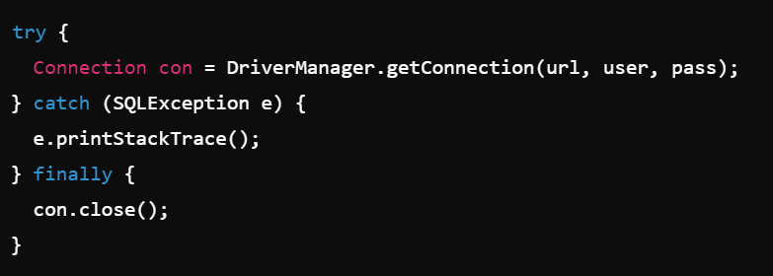
Exception Handling in JDBC
Always handle SQLException in JDBC code
Use try-catch-finally blocks to ensure resources are released
Example of catching SQLException:
Handle specific SQL errors like invalid syntax and connection failures

Slide 52
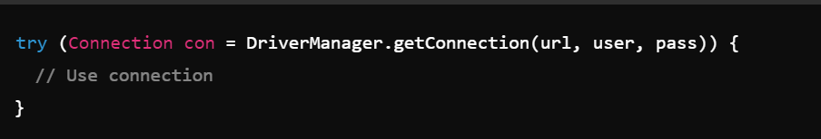
Closing Resources
Always close Connection, Statement, and ResultSet objects
Use try-with-resources in Java 7+ for automatic resource management
Closing resources prevents memory leaks and ensures proper cleanup

Slide 53
Security Best Practices
Use PreparedStatement to prevent SQL injection
Avoid hard-coding credentials in your code
Store sensitive data like passwords securely
Use SSL/TLS encryption for database connections
Ensure proper privilege management for database users

Slide 54
Performance Optimization in JDBC
Use batch processing to handle multiple queries efficiently
Optimize SQL queries to reduce database load
Use connection pooling for better resource management
Avoid unnecessary auto-commit operations for better performance
Properly index tables in the database to optimize query execution

Slide 55
Summary

Slide 56
Summary of JDBC Concepts
JDBC allows Java applications to interact with databases
Supports both SQL querying and database updates
Offers a wide range of functionality, including transactions and batch processing
Provides different interfaces for different query types (Statement, PreparedStatement, etc.)

Slide 57
Recap of Key Components
JDBC API provides a standard method to access databases
DriverManager manages database drivers and connections
Connection interface represents the communication session
Statement and PreparedStatement are used to execute SQL queries
ResultSet is used to handle data retrieved from queries

Slide 58
Advantages of Using JDBC
Cross-platform compatibility allows for universal database access
Provides a secure and efficient way to query and update databases
JDBC’s transaction management ensures data integrity
Handles multiple database drivers in a single application
Simplifies database access in Java enterprise applications

Slide 59
JDBC in Real-World Applications
Commonly used in web applications with a relational database backend
Supports enterprise-level data processing
JDBC is used in a variety of industries, from finance to e-commerce
Enables seamless integration with legacy databases using ODBC bridges

Slide 60
Closing Remarks
JDBC is an essential API for database-driven applications in Java
Its flexibility and robustness make it a popular choice for developers
Mastering JDBC enables you to build data-centric applications

